Slide 1
THE SCIENCE OF CAR PRICE PREDICTION

Slide 2
TABLE OF CONTENT
TITLE
CONTENT
THE TEAM
RESULTS
REFERENCES
METHODOLOGY
CONCLUSION
INTRODUCTION
PROPOSED SOLUTION
BUSINESS PROBLEM
FEATURE ENGINEERING
EXPLORATORY DATA ANALYSIS
DEPLOYMENT ON FLASK
USER INTERFACE DEMO
MODEL DEPLOYED

Slide 3
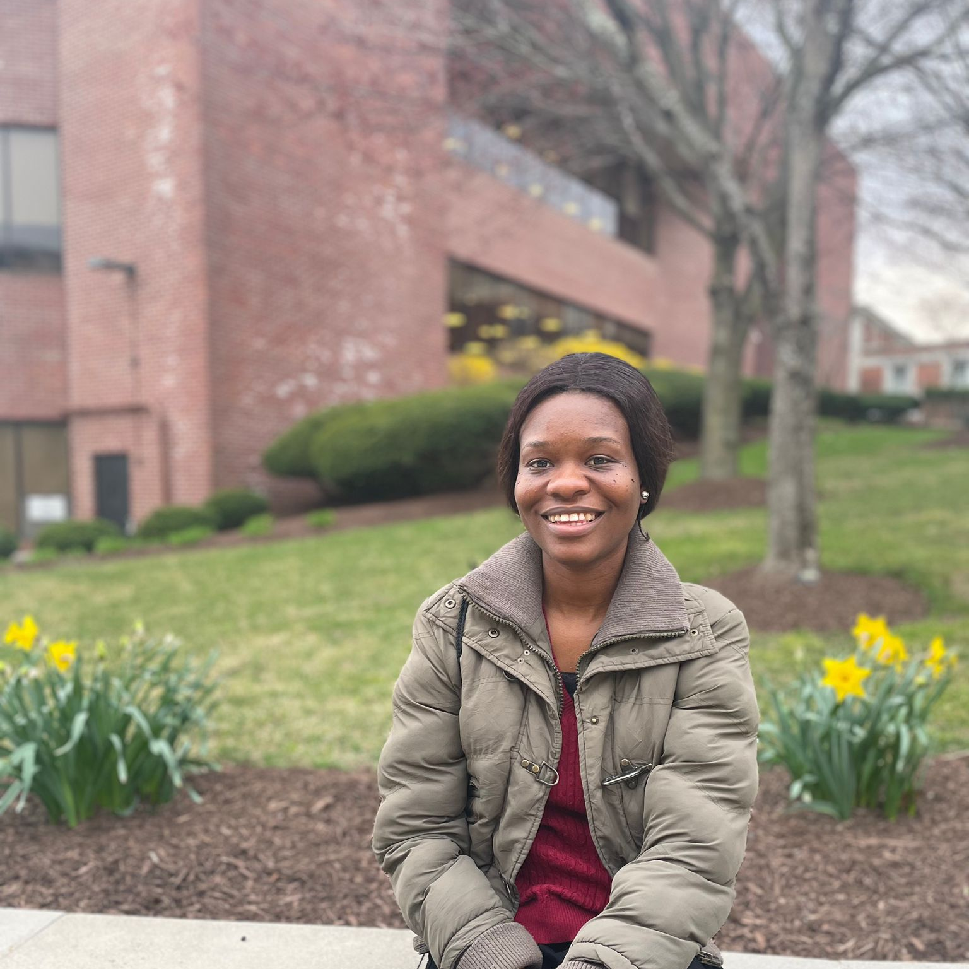
THE TEAM
AKSHAY KUMAR
TEAM LEADER
YESWANTH GOLLA
DATA ANALYST
DEEPA ANABATHULA
DATA SCIENTIST
CHUKWUMA IJEOMA
DATA ENGINEER

Slide 4
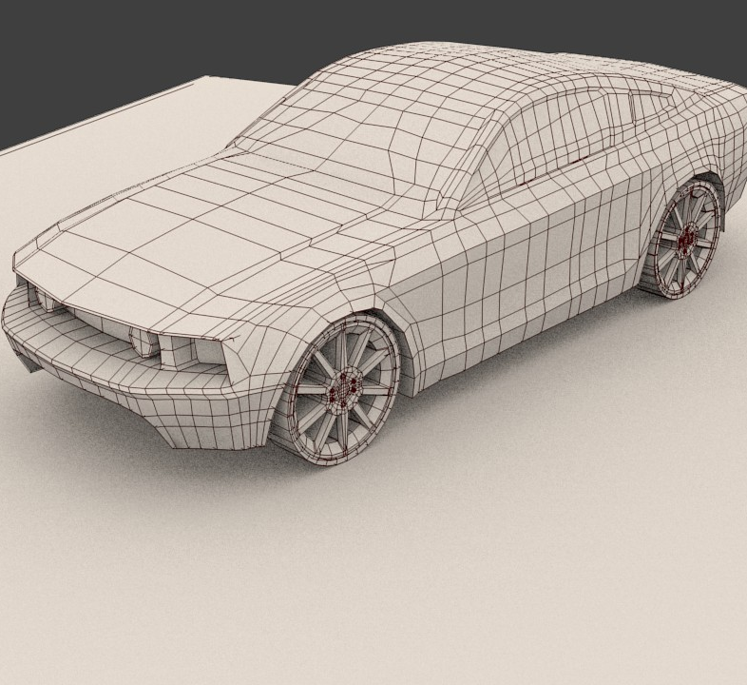
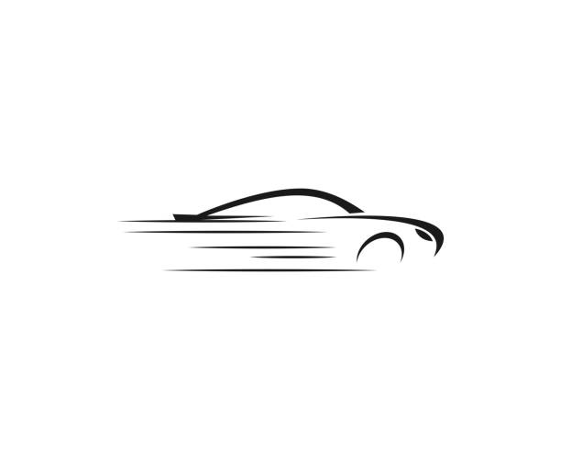
Introduction
Considering factors like mileage, manufacturing year, fuel consumption, and transmission.
We build a model that incorporates a user-friendly interface to aid in informed decision making.

Slide 5
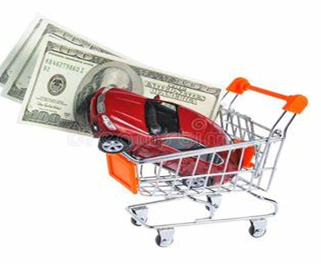
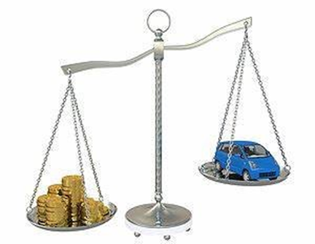
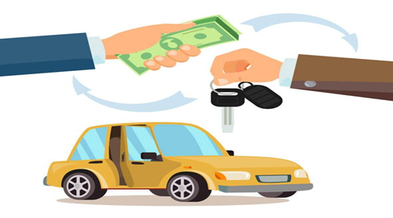
BUSINESS PROBLEM
FEE FIASCO
DEAL OR NO DEAL
VALUATION OPTIMIZATION

Slide 6
PROPOSED SOLUTION
BUILD A SYSTEM OF TRANSPARENCY TO ILLUMINATE VALUE
REVOLUTIONIZE CAR SALES WITH DATA INSIGHTS
THE BIG CAR 'P.P' MODEL

Slide 7
MODEL DEPLOYED

Slide 8
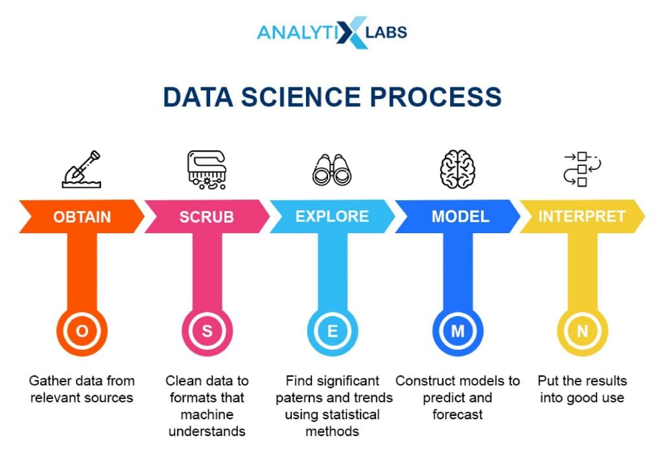
METHODOLOGY

Slide 9
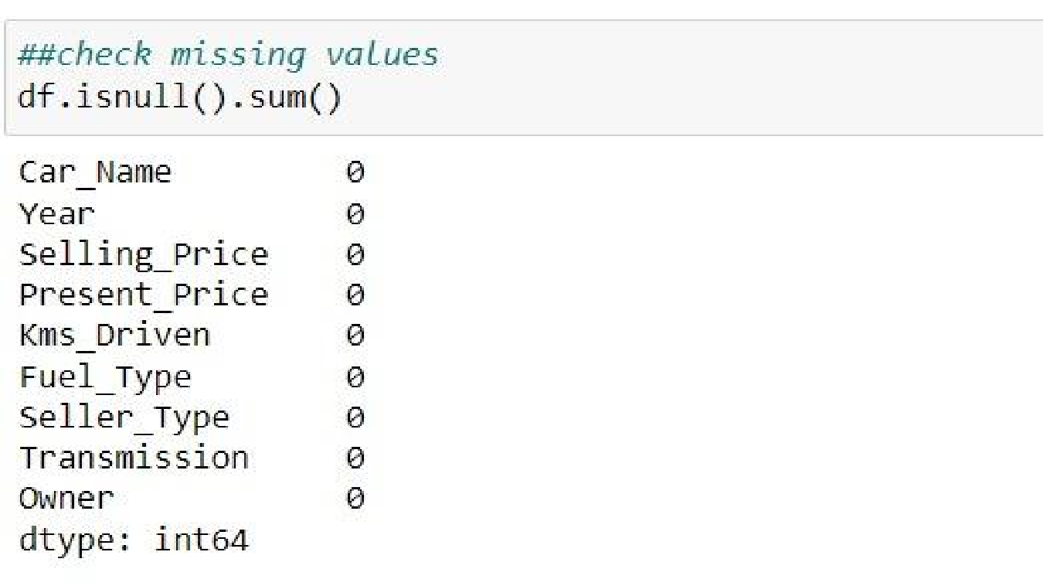
EXPLORATORY DATA ANALYSIS understanding the dataset and how it answers the business problem

Slide 10
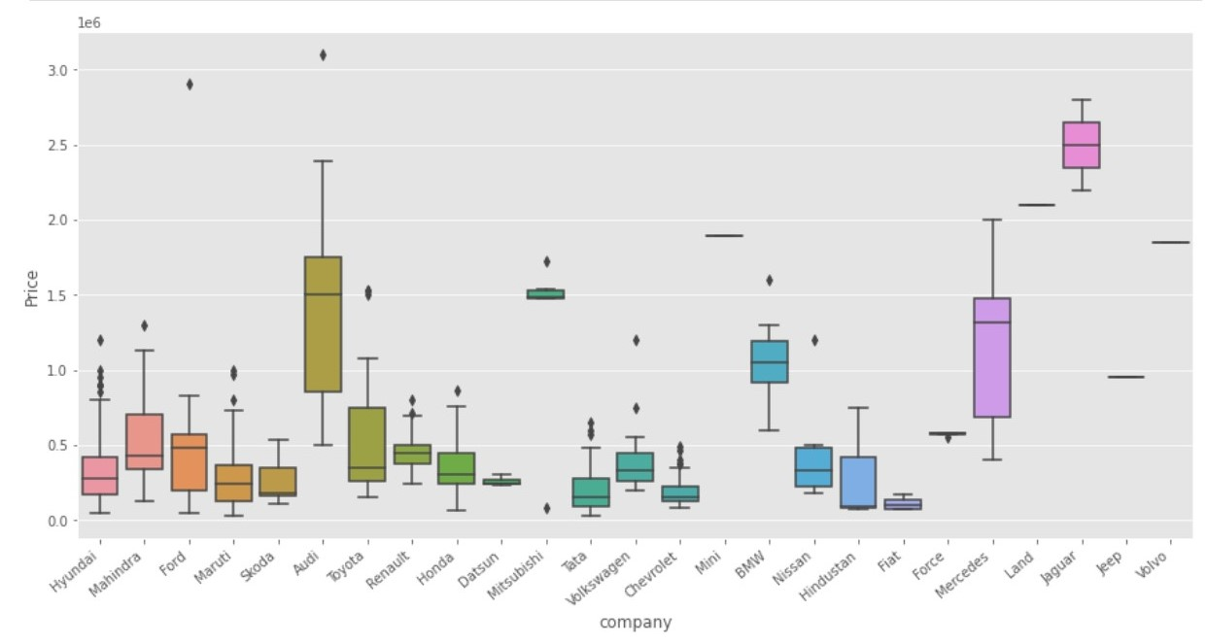
FEATURE ENGINEERING Crafting relevant FEATURES TO enhance THE model's ability to capture patterns and relationships within the data, leading to improved predictive performance.

Slide 11
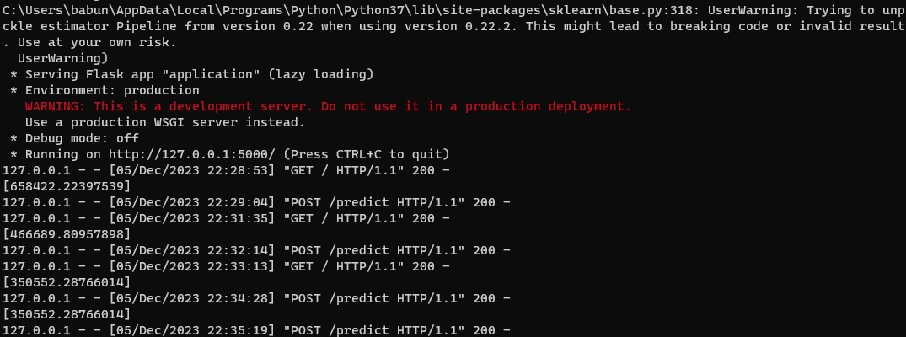
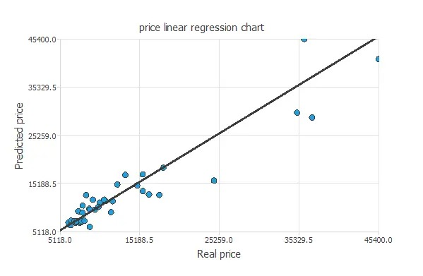
HOSTING ON FLASK
FLASK APPLICATION
LINEAR REGRESSION

Slide 12
USER INTERFACE DEMO

Slide 13
RESULTS

Slide 14
CONCLUSION
Determining the worth of a used car solely by looking at advertisements can be a challenging task. Various factors such as mileage, make, model, year, and other characteristics can significantly influence the true value of a car. For sellers, accurately pricing a pre-owned vehicle can be a daunting endeavor. Therefore, the utilization of machine learning algorithms can aid in the creation of models that predict used car prices based on specific car features.

Slide 15
REFERENCES:
https://towardsdatascience.com/predicting-car-price-using-machine-learning-8d2df3898f16
https://scholarworks.rit.edu/cgi/viewcontent.cgi?article=12220&context=theses
https://medium.com/geekculture/used-carprice-prediction-complete-machine-learning-project-d25559cf2d2a

Slide 16
THANK YOU
GROUP10-DATA-ENGINEERING-UNH

